Slide 1
Spanning Tree Protocol
(STP)
Part II
Thanks to St. Clair College in Windsor, Ontario.

Slide 2
Spanning Tree Protocol (STP)
PVST+, RTSP and Rapid PVST+
Per-VLAN Spanning Tree (PVST)
Per-VLAN Spanning Tree Plus (PVST+)
Rapid Per-VLAN Spanning Tree Plus (Rapid PVST+)
Rapid Spanning Tree (RSTP)
Multiple Spanning Tree Protocol (MSTP)

Slide 3
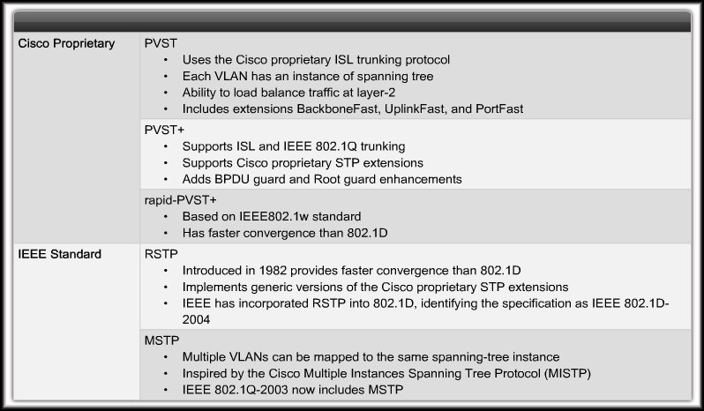
Cisco and IEEE STP Variants

Slide 4
PVST+ (Cisco)
A network can run an STP instance for each VLAN in the network.
The VLAN needs to be identified, so each BID has 3 fields: priority, extended system ID field, containing VID, MAC address.
Default for Cisco 2960 switches.
Cisco proprietary.

Slide 5
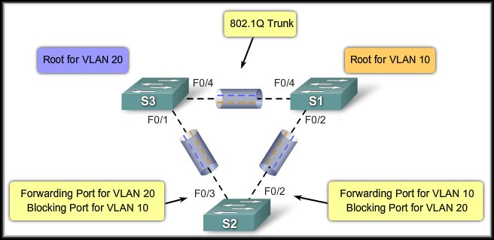
PVST+ (Cisco)

Slide 6
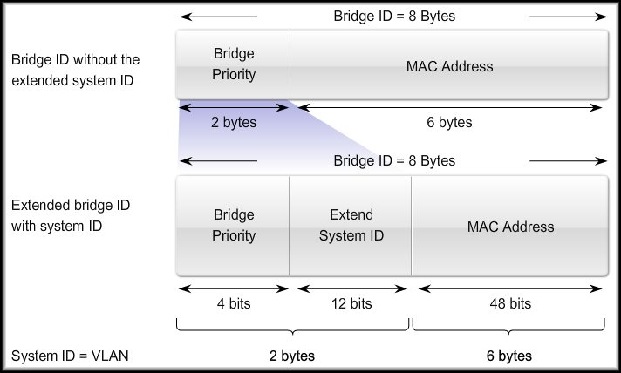
PVST+ (Cisco)
Extended System-ID

Slide 7
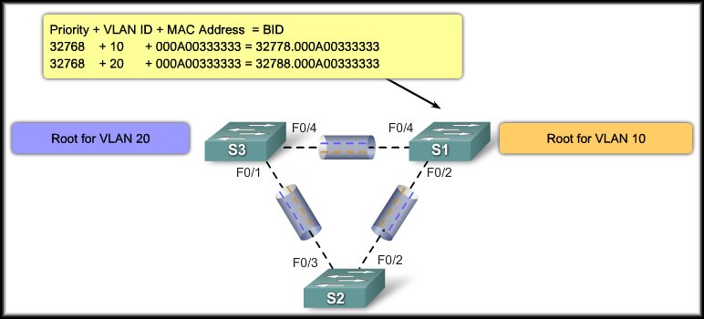
PVST+ (Cisco)
Extended System-ID

Slide 8
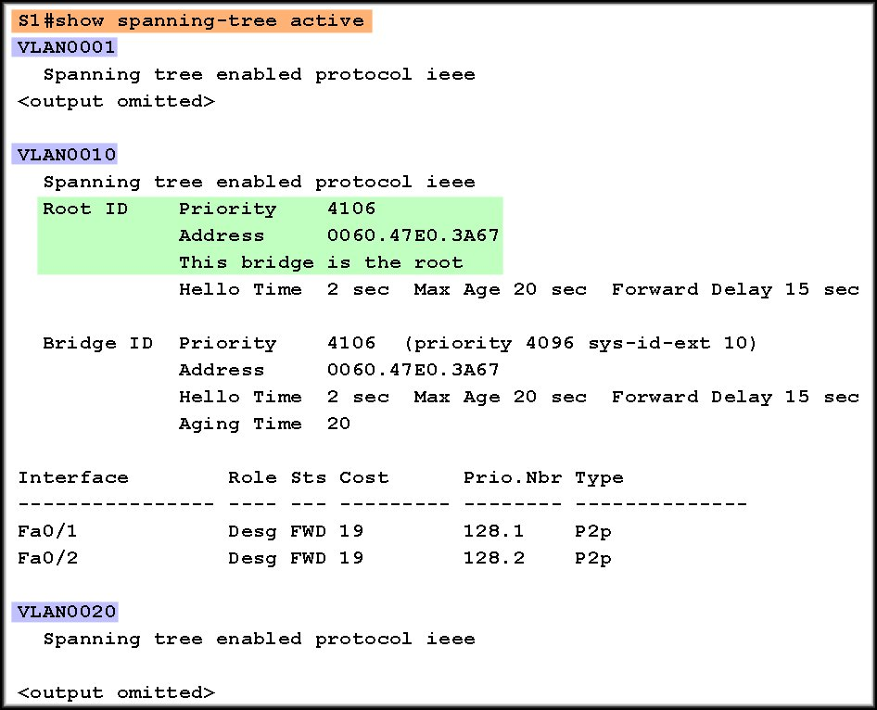
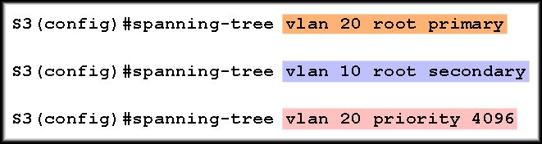
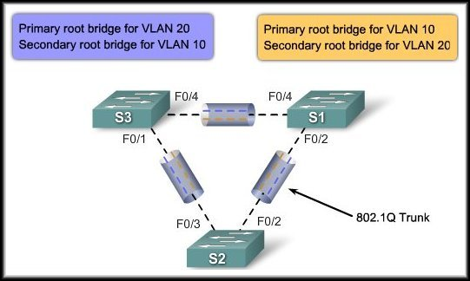
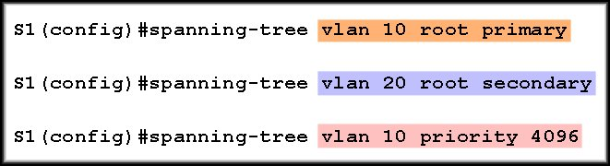
Configure PVST+

Slide 9
RSTP
Rapid Spanning Tree Protocol
IEEE802.1w

Slide 10
Rapid Spanning-Tree Protocol
An evolution of the 802.1D (STP) standard.
Most parameters have been left unchanged.
Speeds the recalculation of the spanning tree on a topology change by redefining the type of ports and their state.

Slide 11
RSTP Characteristics
  Preferred protocol for switches.
  Retains backward compatibility to STP (802.1D).
    Keeps the same BPDU format with the version field is set to 2 to indicate RSTP.
    Root election same.
    Sends BPDUs every 2 seconds.
  3 missed BPDUs taken to mean loss of the link. (6 seconds)

Slide 12
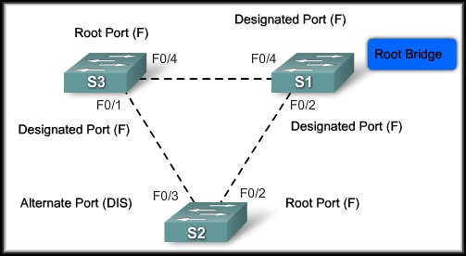
RSTP Characteristics:
Much faster to converge.
  Different port roles and states.
  Does not use timers in the same way.

Slide 13
RSTP- Rapid Transition Feature
Rapid Transition to Forwarding State:
    A port can safely transition to the forwarding state without having to rely on any timer configuration.
    In order to achieve fast convergence on a port, the protocol relies upon two new variables:
      Edge Ports
      Link Type.

Slide 14
Rapid Spanning-Tree Protocol (RSTP)
Edge Ports:
  An edge port is a switch port that is never intended to be connected to another switch device.
  It immediately transitions to the forwarding state when enabled.
  Does this sound like anything we’ve already discussed?
Cisco - Portfast
Non-Edge Ports:
  A non-edge port is a switch port that is always intended to be connected to another switch device.

Slide 15
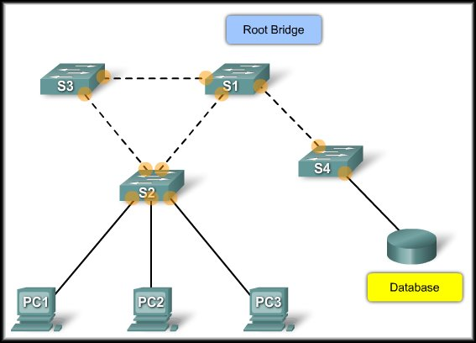
Rapid Spanning-Tree Protocol (RSTP)
Non-Edge Ports
Edge Ports

Slide 16
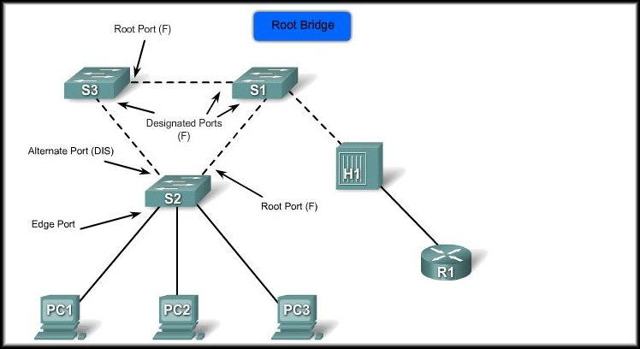
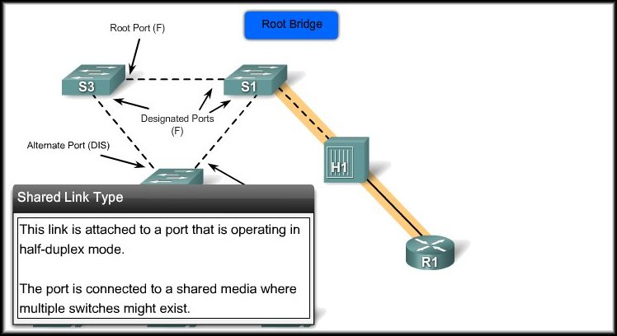
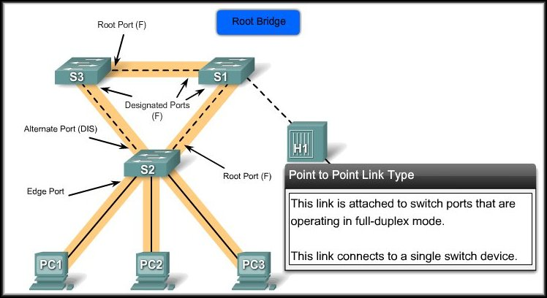
Rapid Spanning-Tree Protocol (RSTP)
Link Types:
  The link type provides a categorization for each port participating in RSTP.
  Non-edge ports are categorized into two link types:
    Point-to-point:
      Connects to a single network device.
    Shared:
      Connects to a shared media where more switches may exist.
  The link type is automatically derived from the duplex mode of a port but this can be overridden.

Slide 17
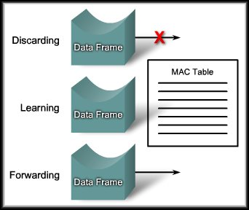
Rapid Spanning-Tree Protocol (RSTP)
Port States:
  Discarding:
    Prevents the forwarding of data frames.
  Learning:
    Accepts data frames to populate the MAC table.
  Forwarding:
    Forwards data frames and determines the topology.

Slide 18
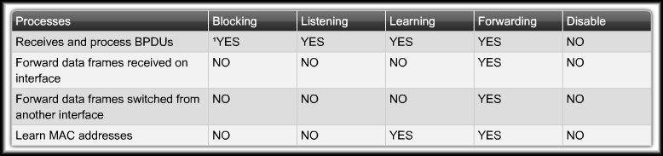
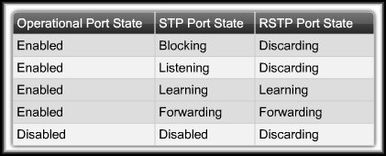
Rapid Spanning-Tree Protocol (RSTP)
STP
RSTP

Slide 19
Rapid Spanning-Tree Protocol (RSTP)
Port Roles:
  The port role defines the ultimate purpose of a switch port and how it handles data frames. Port roles and port states are able to transition independently of each other.
    Root Port
    Designated Port
    Alternate Port
    Backup Port
  Creating the additional port roles allows RSTP to define a standby switch port before a failure or topology change.

Slide 20
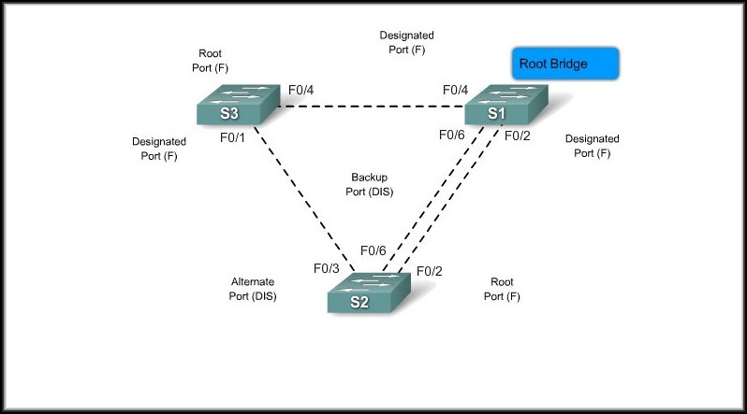
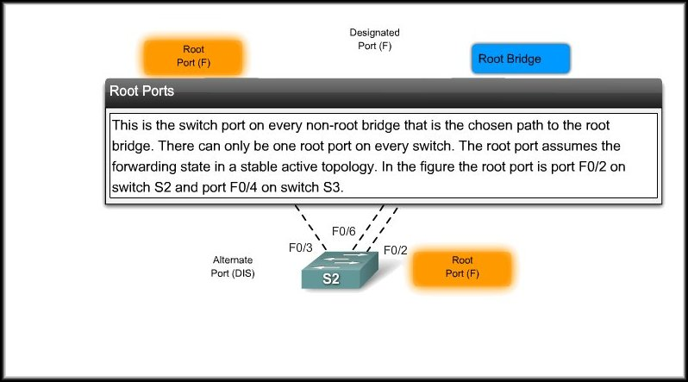
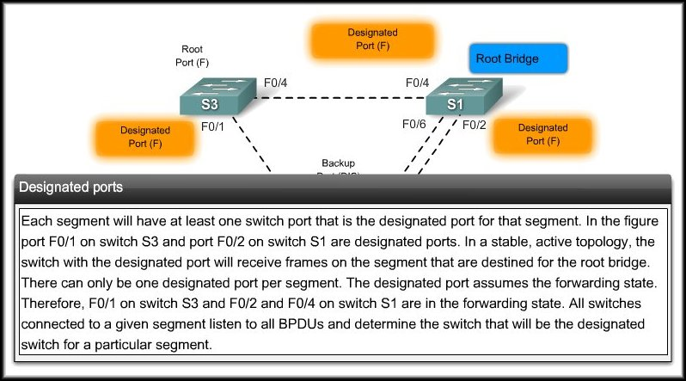
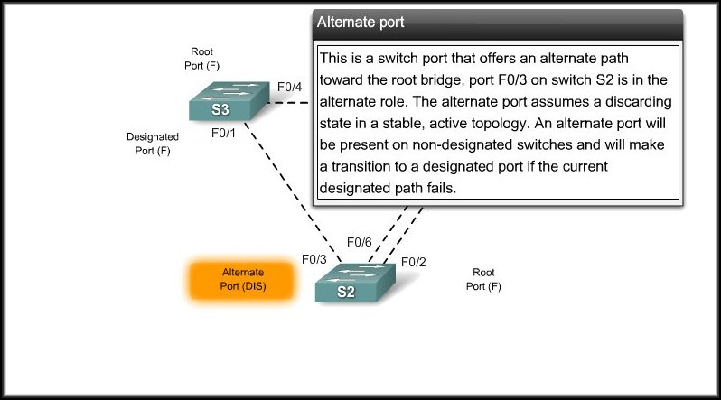
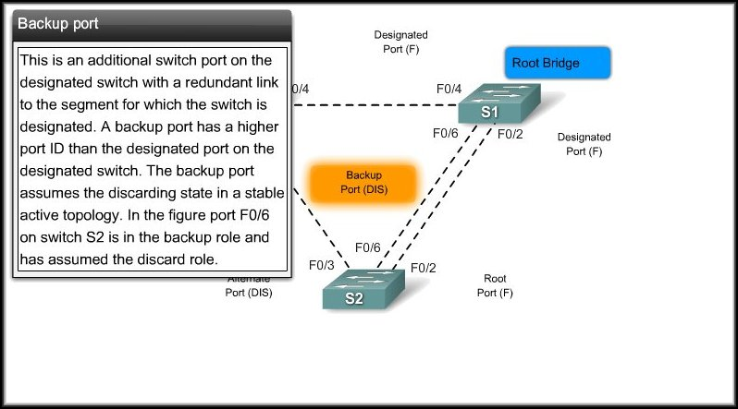
Rapid Spanning-Tree Protocol (RSTP)
Port Roles:

Slide 21
RSTP port roles
Forwarding
Root port
Designated port
Edge port – not to switch
Discarding
Backup port
Alternate port
Both are closed down but are ready to take over at once

Slide 22
RSTP Proposal and Agreement Process
In IEEE 802.1D STP:
  A designated port must wait two times the forward delay before transitioning the port to the forwarding state.
RSTP:
  Significantly speeds up the recalculation process after a topology change.
  It converges on a link-by-link basis and does not rely on timers expiring before ports can transition.
  Only on edge ports and point-to-point links.

